Slide 1
Extending Scikit-Learn with your own Regressor
25th July, Florian Wilhelm, Berlin
EuroPython 2014

Slide 2
What is Scikit-Learn?
The Theil-Sen Estimator
Writing a Scikit-Learn Estimator
Contributing to Scikit-Learn
My Experiences

Slide 3

What is Scikit-Learn?
Machine Learning Library
Simple and efficient tools for data mining and data analysis
Accessible to everybody, and reusable in various contexts
Built on Numpy, Scipy, and matplotlib
Open source, commercially usable - BSD licensed

Slide 4

Scikit-Learn’s basic areas of application

Slide 5
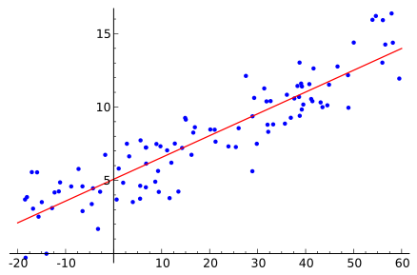
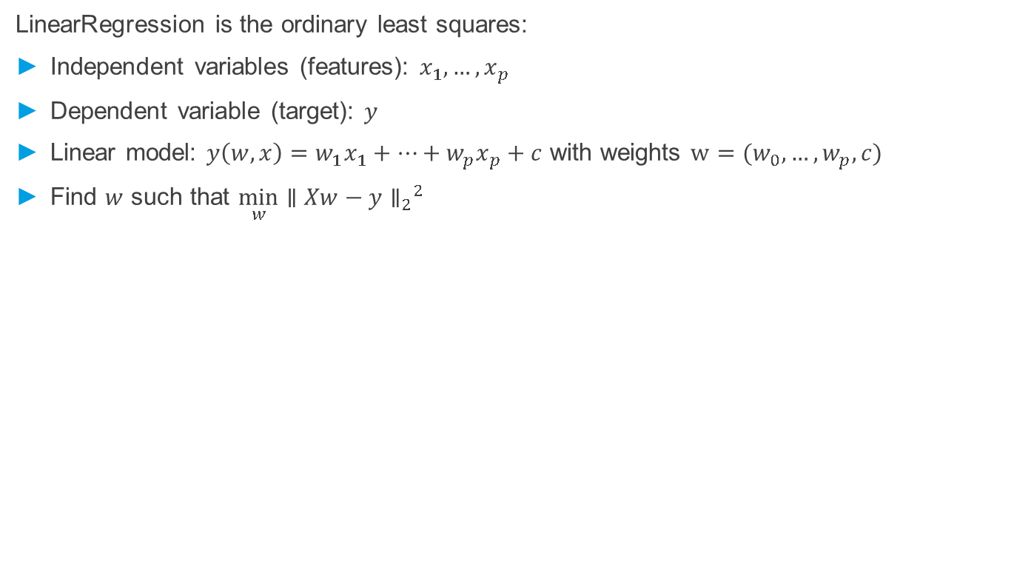
Least Squares / Linear Regression
LinearRegression is the ordinary least squares:
Independent variables (features): $x_{1}, …,x_{p}$
Dependent variable (target): $y$
Linear model: $y\left(w, x\right)=w_{1}x_{1}+…+w_{p}x_{p}+c$ with weights $w=(w_{0},…, w_{p}, c)$
Find $w$ such that ${{\min_{w}{{∥Xw−y∥}_{2}}}^{2}}_{}$

Slide 6
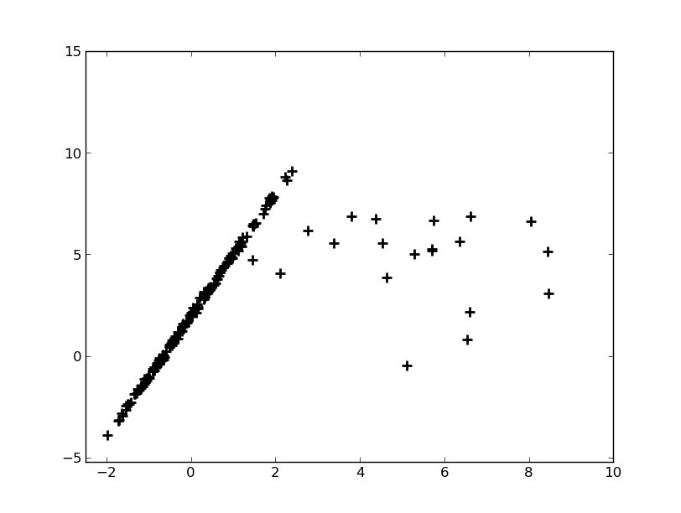
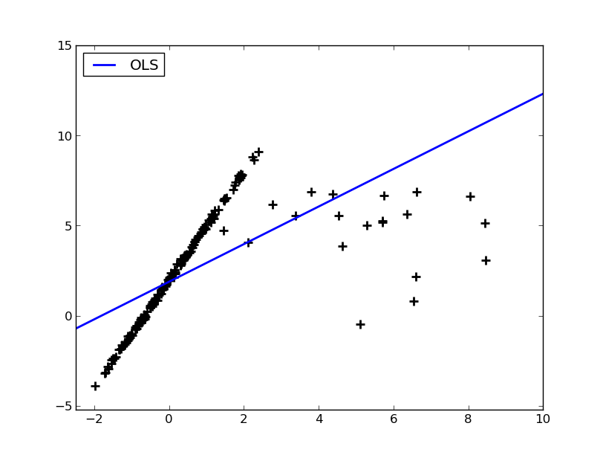
Problems with Outliers
Corrupted data or outliers easily leads to wrong results with least squares:

Slide 7

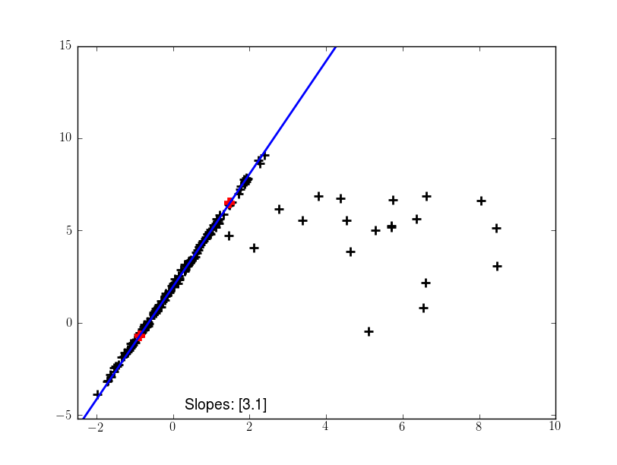
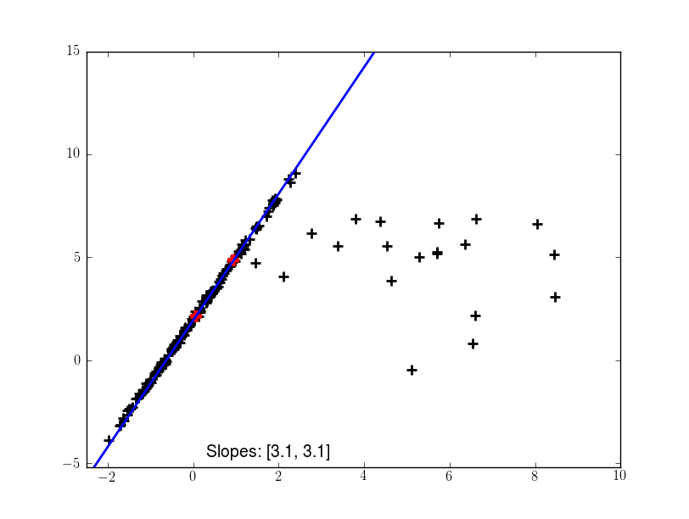
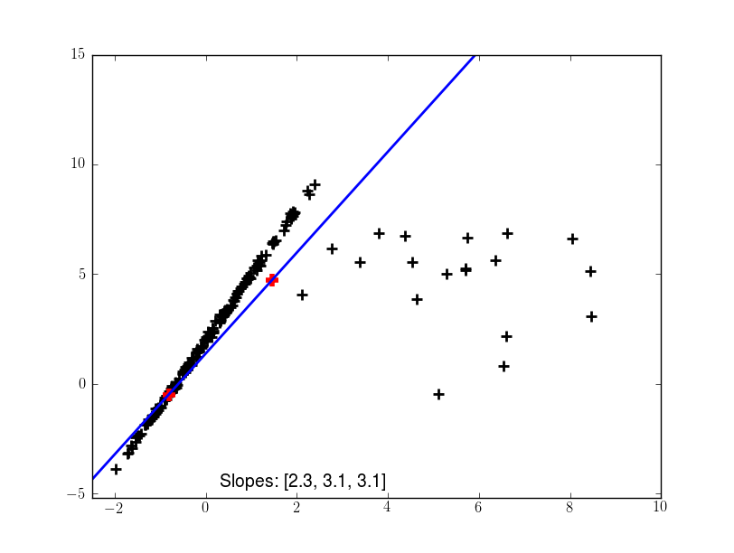
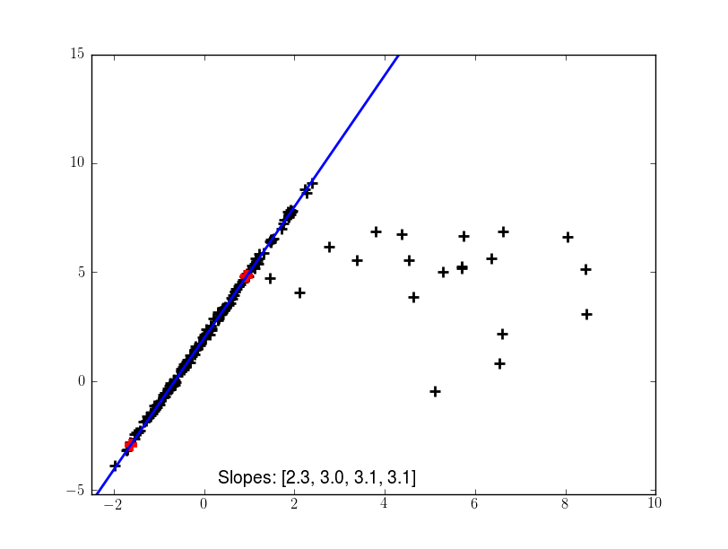
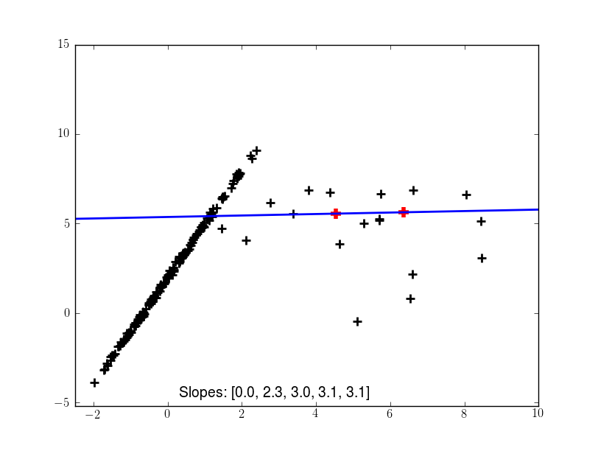
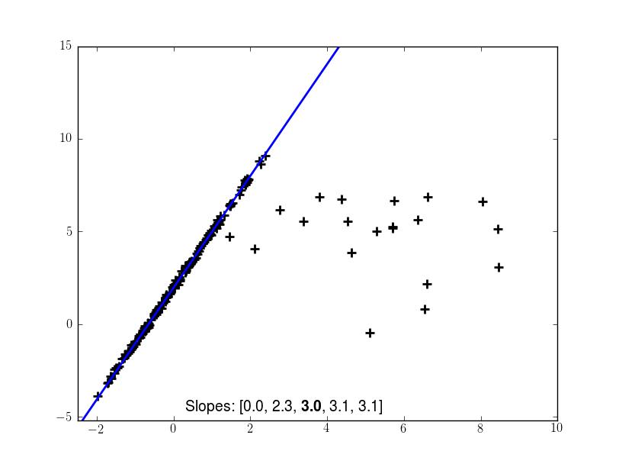
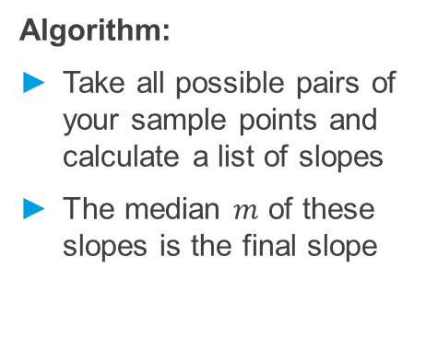
How Theil-Sen avoids Outliers
Algorithm:
Take all possible pairs of your sample points and calculate a list of slopes
The median $m$ of these slopes is the final slope
The Theil-Sen estimator can also be extended to n dimensions (X. Dang, H. Peng, X. Wang, H. Zhang: Theil-Sen Estimators in a Multiple Linear Regression Model)

Slide 8
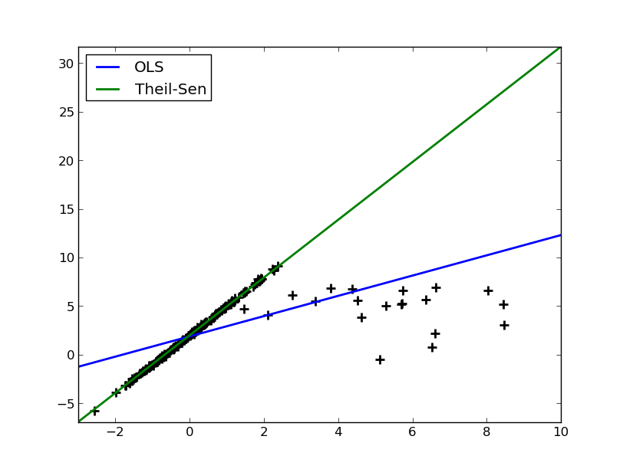
Theil-Sen vs. Least Squares

Slide 9
Writing an own Estimator/Regressor
Regressor needs:
set_params(self, **params)
get_params(self, deep=True)
fit(self, X, y)
predict(self, X)
LinearModel
Base Estimator
Theil Sen
Mixins:
ClassifierMixin
RegressorMixin
ClusterMixin
TransfomerMixin
…

Slide 10
TheilSen Regressor
class TheilSen(LinearModel, RegressorMixin): def __init__(self, fit_intercept=True, …): self.fit_intercept = fit_intercept
def fit(self, X, y): self.random_state_ = check_random_state(self.random_state) X, y = check_arrays(X, y, sparse_format='dense', dtype=np.float) n_samples, n_features = X.shape
# TheilSen algorithm …
if self.fit_intercept: self.intercept_ = coefs[0] self.coef_ = coefs[1:] else: self.intercept_ = 0. self.coef_ = coefs return self

Slide 11
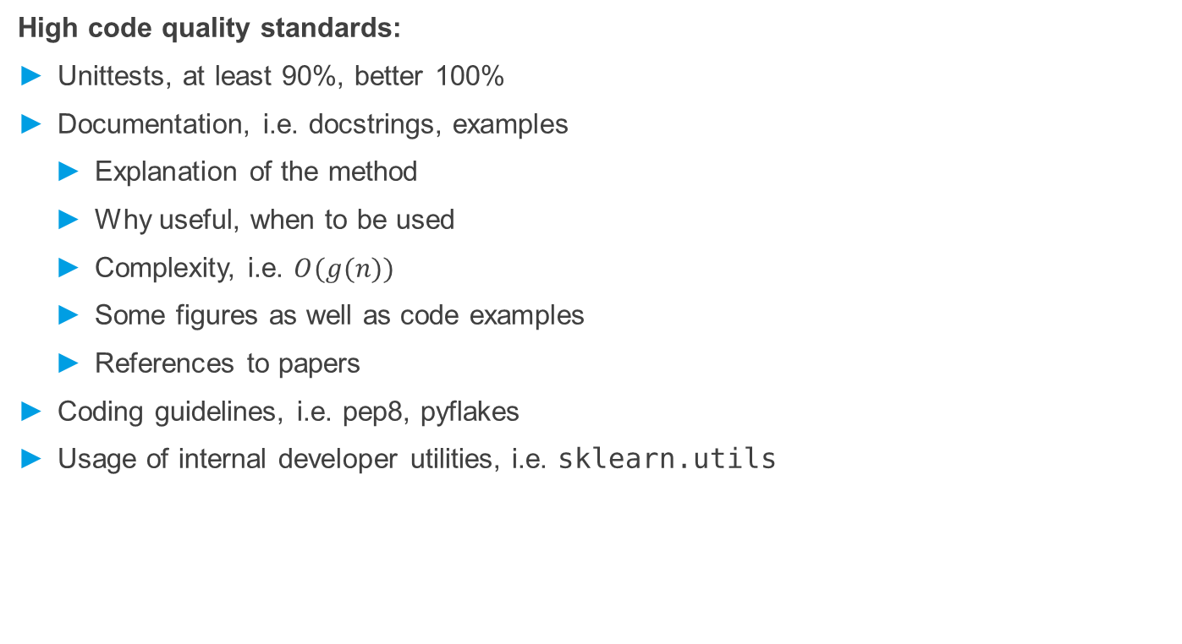
Requirements of a Contribution to Scikit-Learn
High code quality standards:
Unittests, at least 90%, better 100%
Documentation, i.e. docstrings, examples
Explanation of the method
Why useful, when to be used
Complexity, i.e. $O(g(n))$
Some figures as well as code examples
References to papers
Coding guidelines, i.e. pep8, pyflakes
Usage of internal developer utilities, i.e. sklearn.utils

Slide 12
Experiences of my first Scikit-Learn PR
Initial Pull Request on March 8th
Some improvements due to good remarks, regarding:
Performance
Coding guidelines
Lot of discussion:
If Theil-Sen should be better included in Statsmodels
If RANSAC is a superior alternative
https://github.com/scikit-learn/scikit-learn/pull/2949

Slide 13
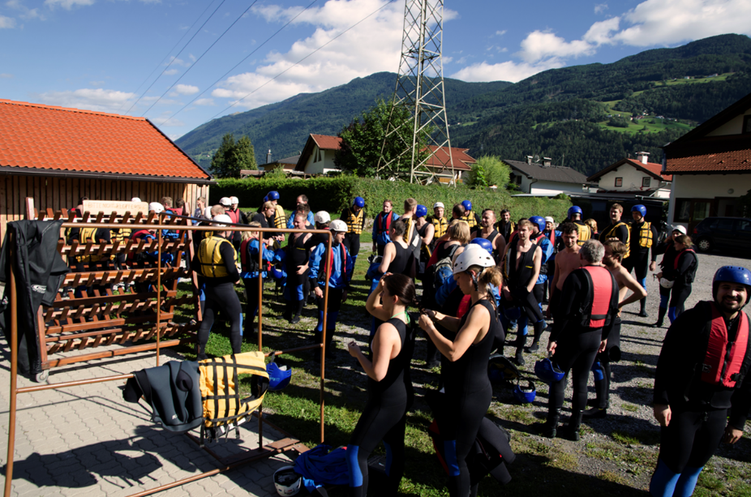









Blue Yonder is hiring!
Please visit our booth at EuroPython 2014

